Slide 1
Gas Chromatography
Matthew McPartlan
Conor Green
ELEC 402: Senior Project
Dr. Asghari

Slide 2
Final Presentation
Spring Semester
Update on detector and carrier gasses
Colorimetric array
Current prototype
GUI, ADC, and software
Demonstrations
Hardware + Software
Future

Slide 3
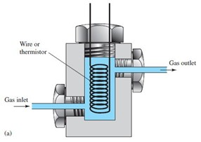
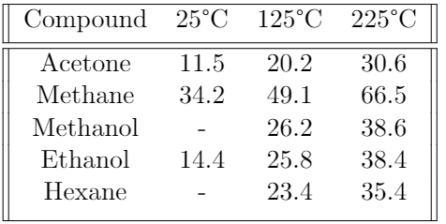
Reminder: Detector Operating Principle
Diode thermal conductivity detector
Does not require an inert carrier gas
Rugged enough for classroom use
Cheap and simple to replace
Poor sensitivity
Increased sample volume can mitigate this somewhat
Note:
Dried air (32mW/(m*K) @ 125C)
Heated Resistive Coil
Thermal Conductivity of Common Analytes (mW/(m*K))
http://www.gaschromatograf.de/documentation_eng.html

Slide 4
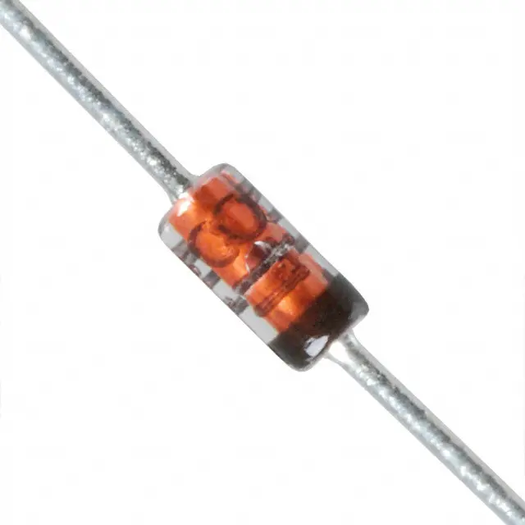
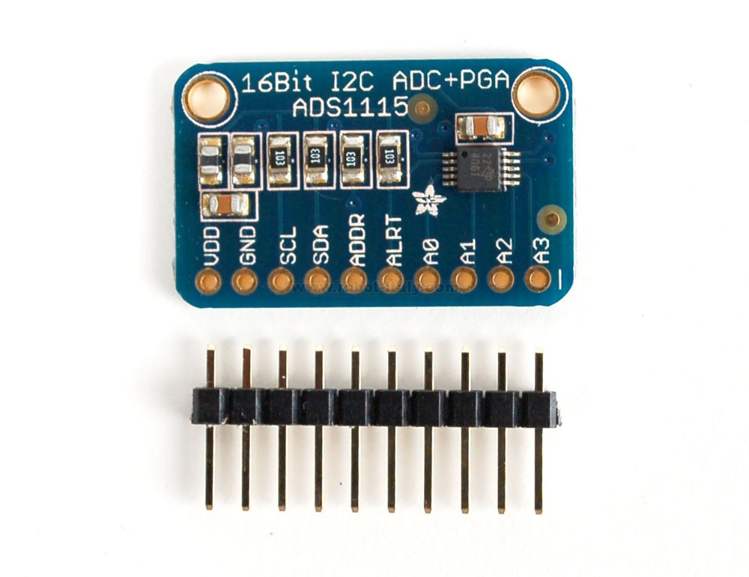
Updated Detector and Carrier Gas Selections
Updated Configuration Selection
1N4148 Diode
Dried air (32 @ 125C)
(1)
Single-ended ADS1115
16-bit precision analog voltage measurement
I²C Communication
Raspberry Pi Library
(2)
https://www.digikey.com/product-detail/en/on-semiconductor/1N4148TR/1N4148FSCT-ND/9356376
http://www.robot-italy.com/media/catalog/product/cache/4/image/d43192dcd82ea942982b4b1d2a6e2479/w/i/window.jpeg

Slide 5
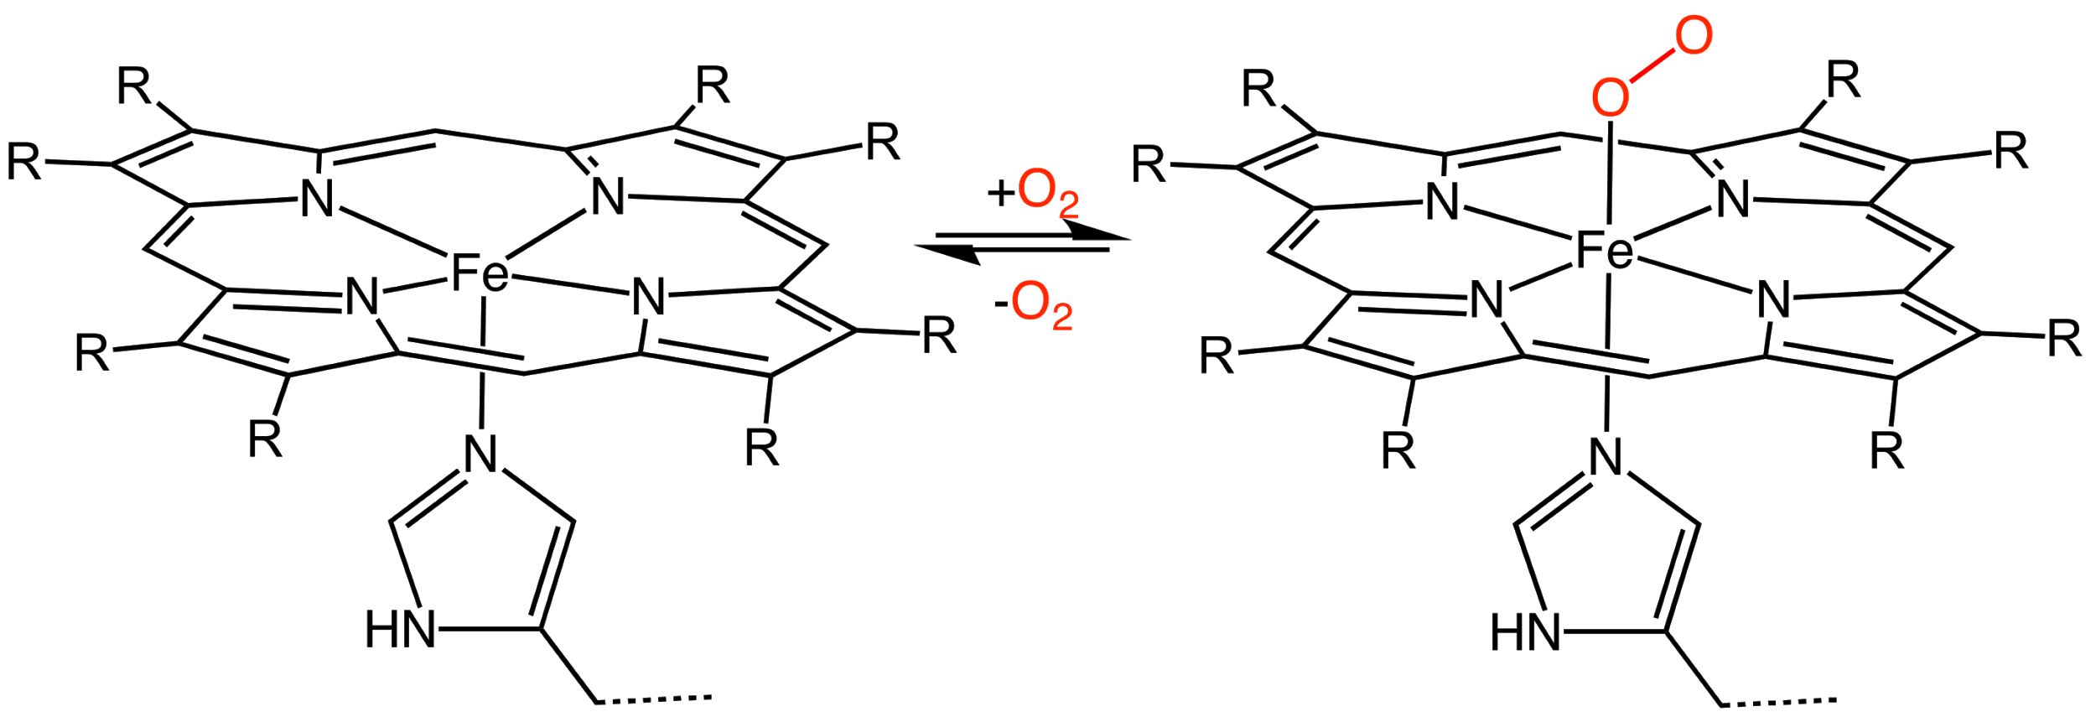
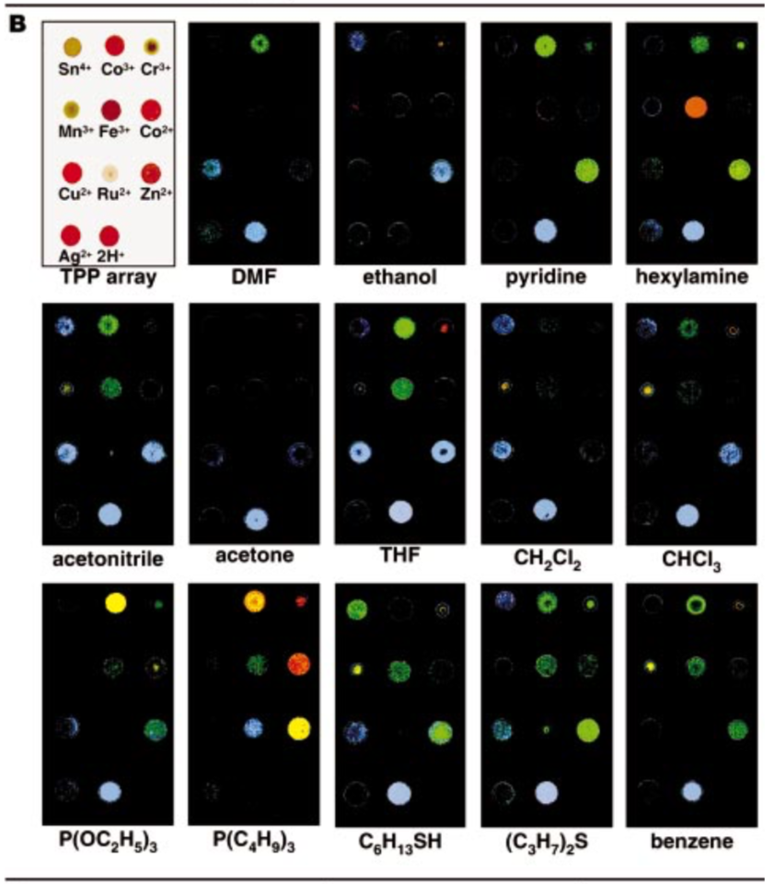
Reminder: Colorimetric Array Detector
Deoxyhemoglobin
Dark red
Fe²⁺ oxidation state
Oxyhemoglobin
Bright red
Fe³⁺ oxidation state
Oxygen ligand
K. Rakow, N. & Suslick. A colorimetric sensor array for odour visualization. Nature, 406:710–713, August 2000.

Slide 6
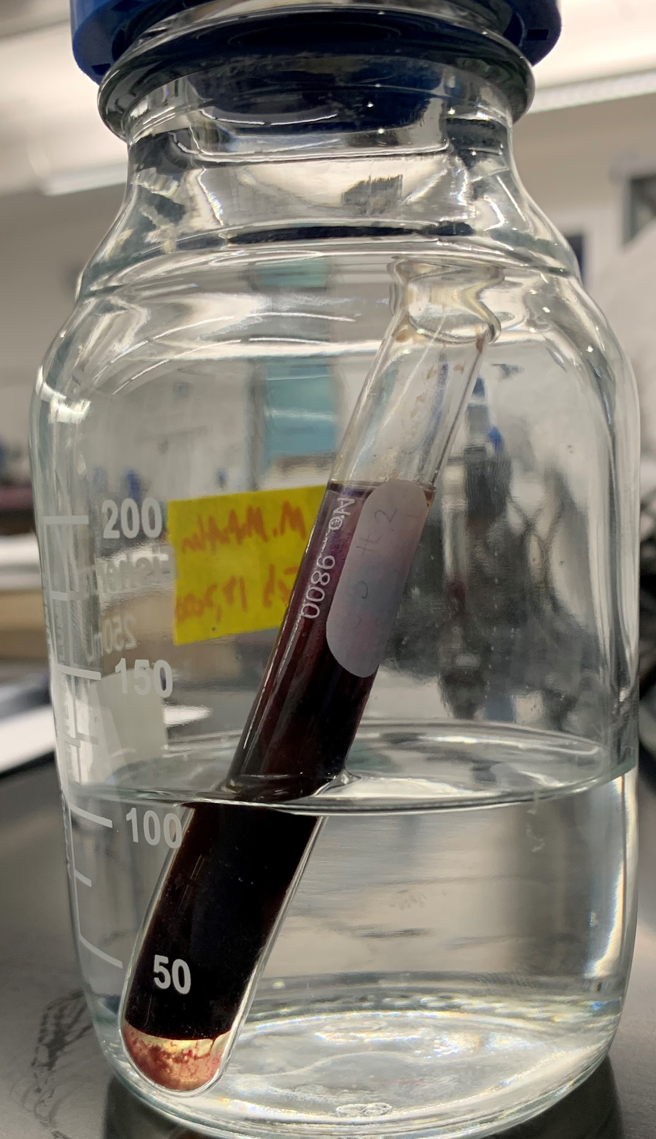
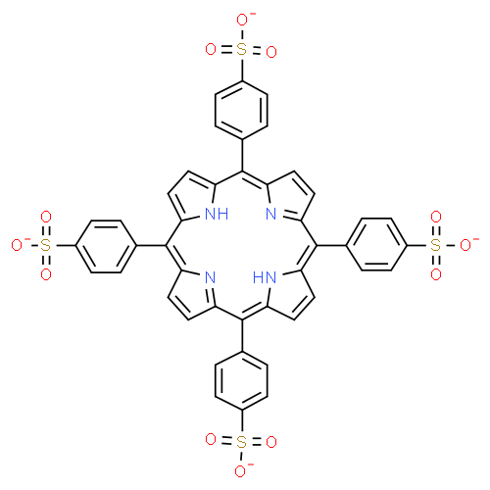
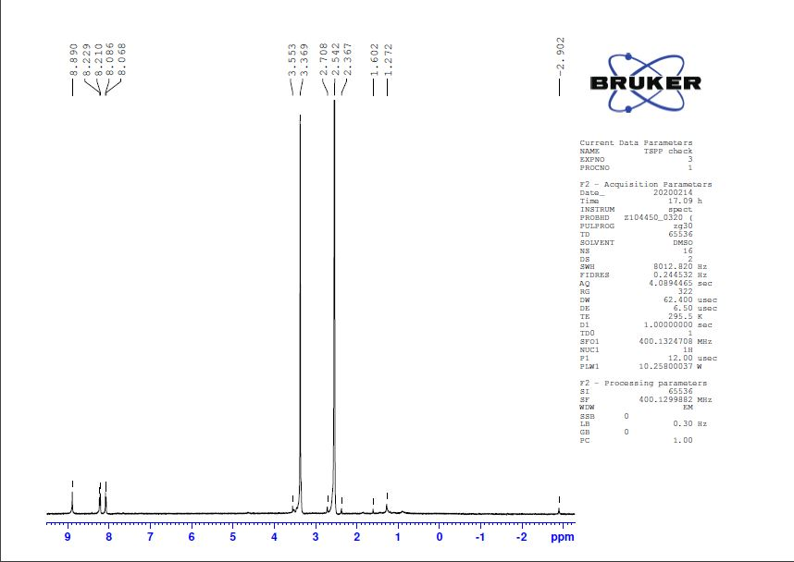
Progress: Colorimetric Array Detector
Innovation: Sulfonate the metalloporphyrin compounds so they can be dissolved in water.
Avoids chloroform, dimethyl sulphoxide (DMSO), and dichloromethane (DCM)
5,10,15,20-tetrakis(4-sulfonatophenyl)porphyrin
(Source: ChemSpider)

Slide 7
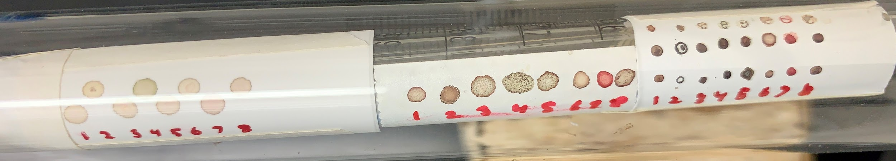
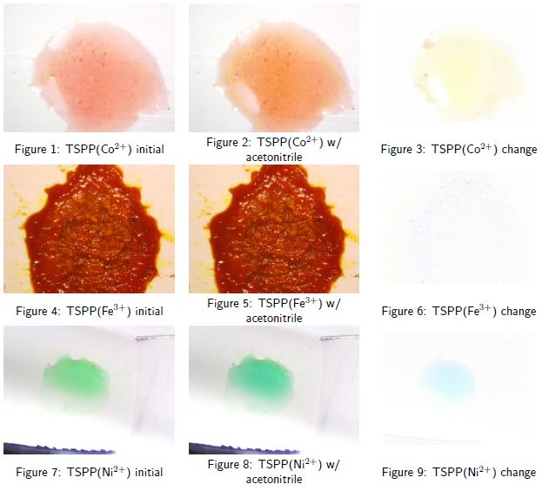
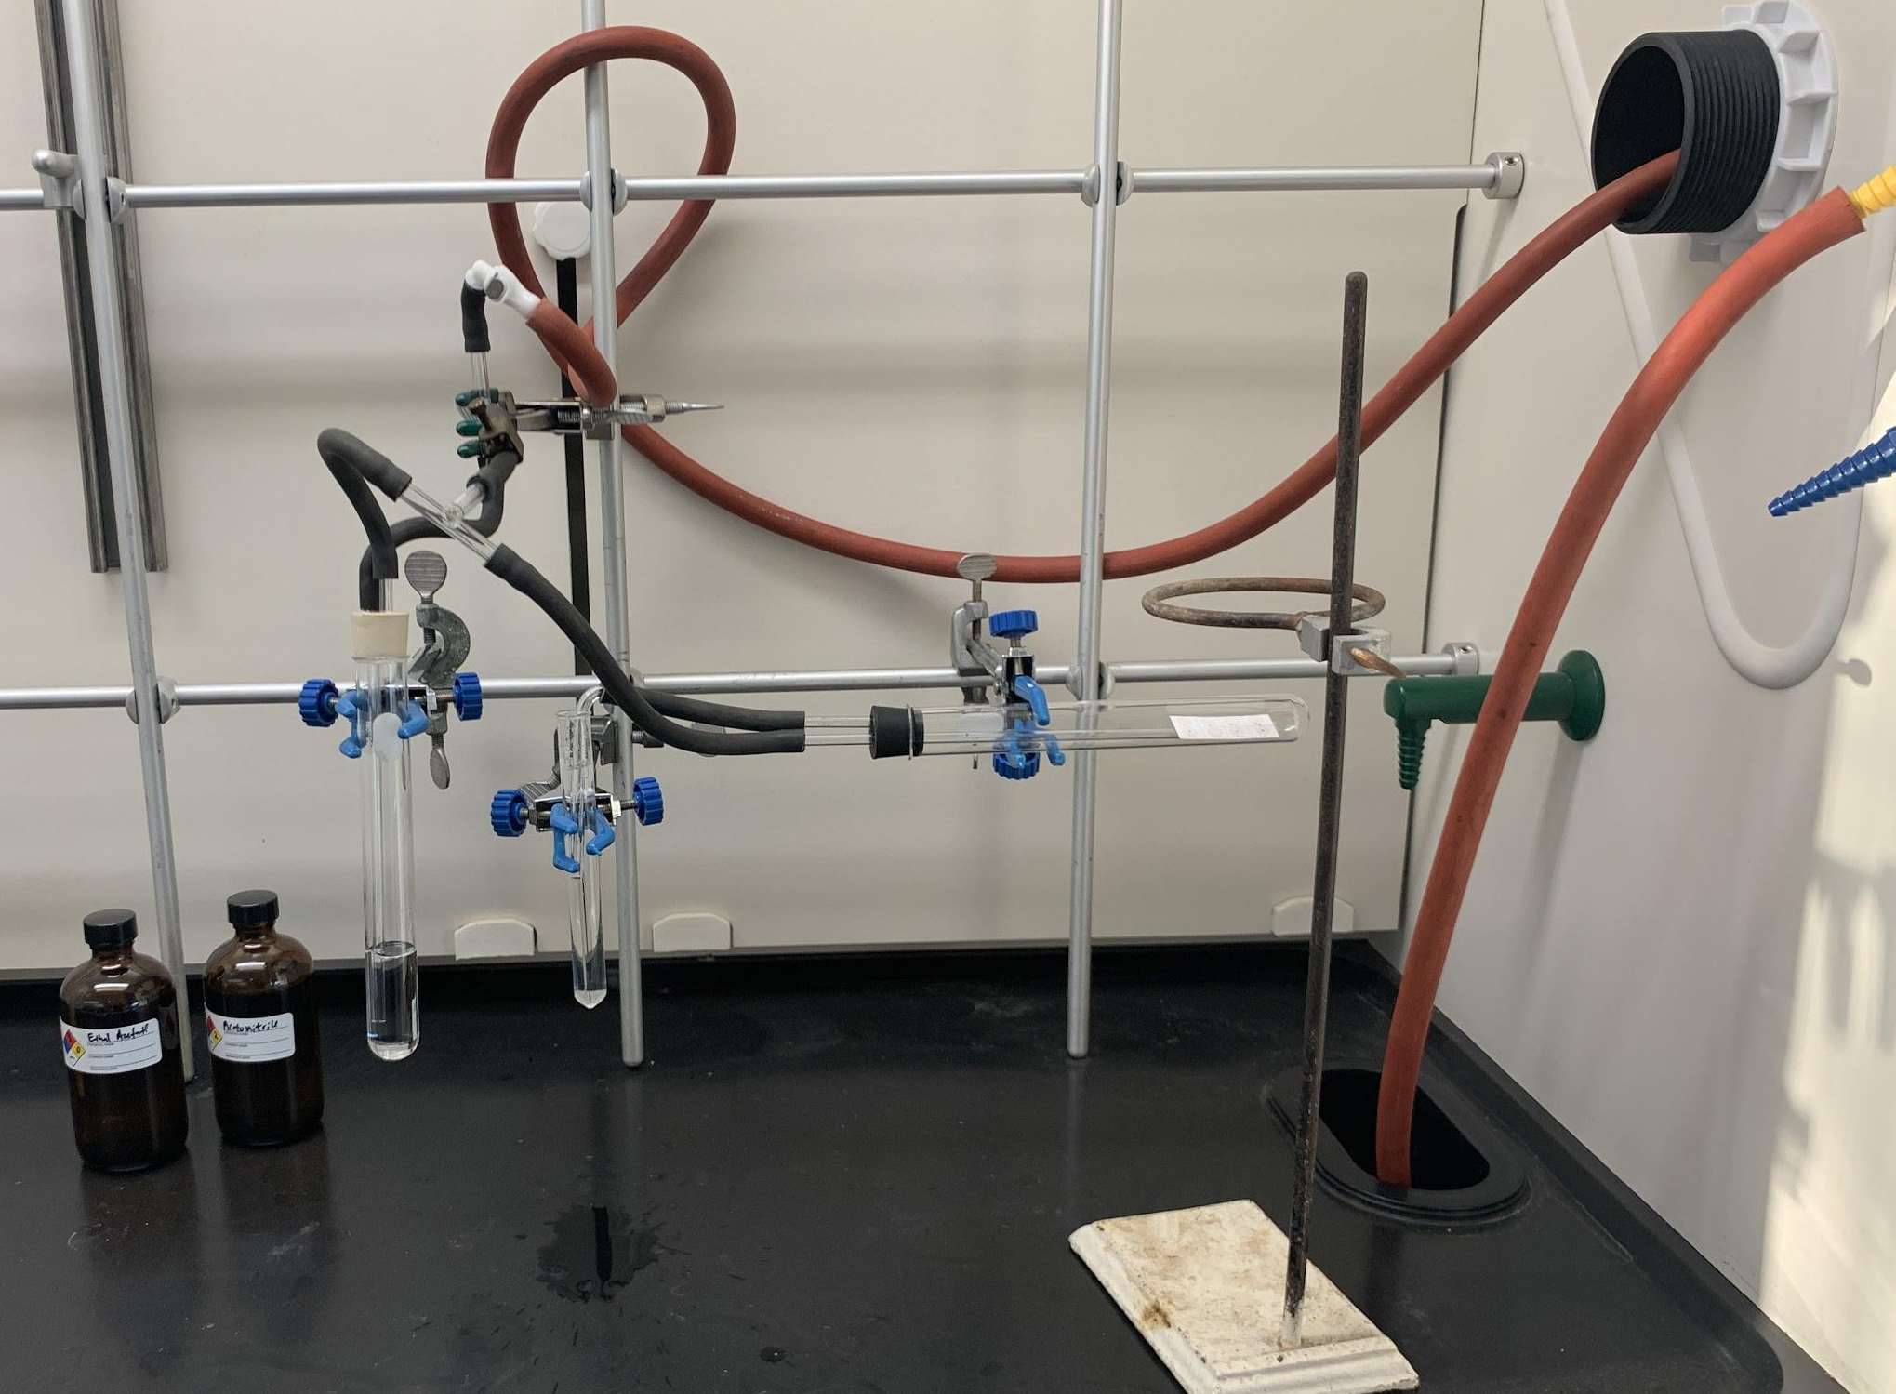
Testing the Colorimetric Array Detector
Unfortunately, this work can not be continued without lab access.

Slide 8
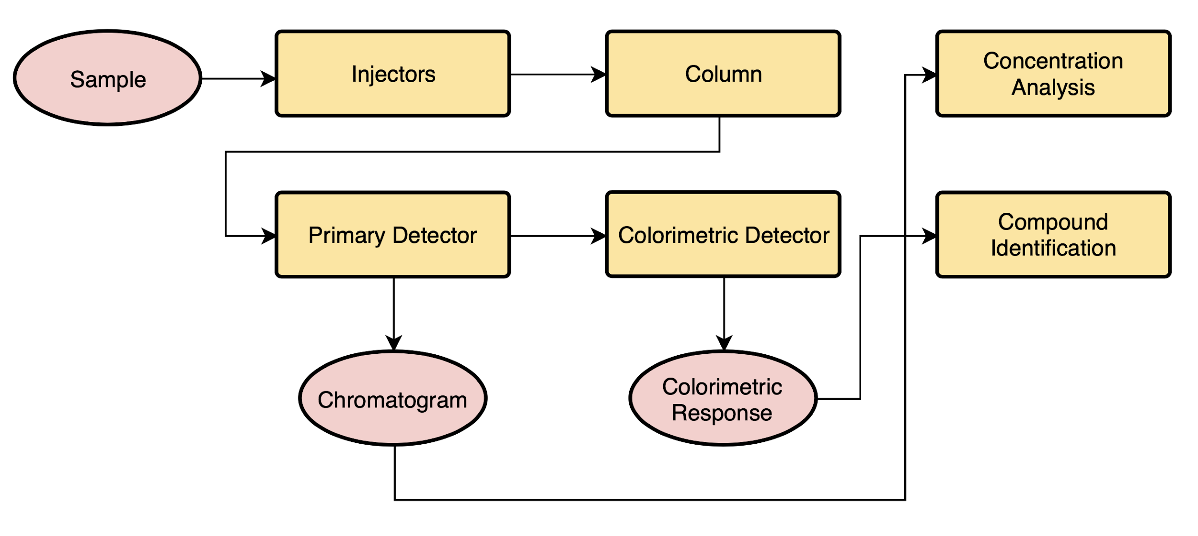
System and Components

Slide 9
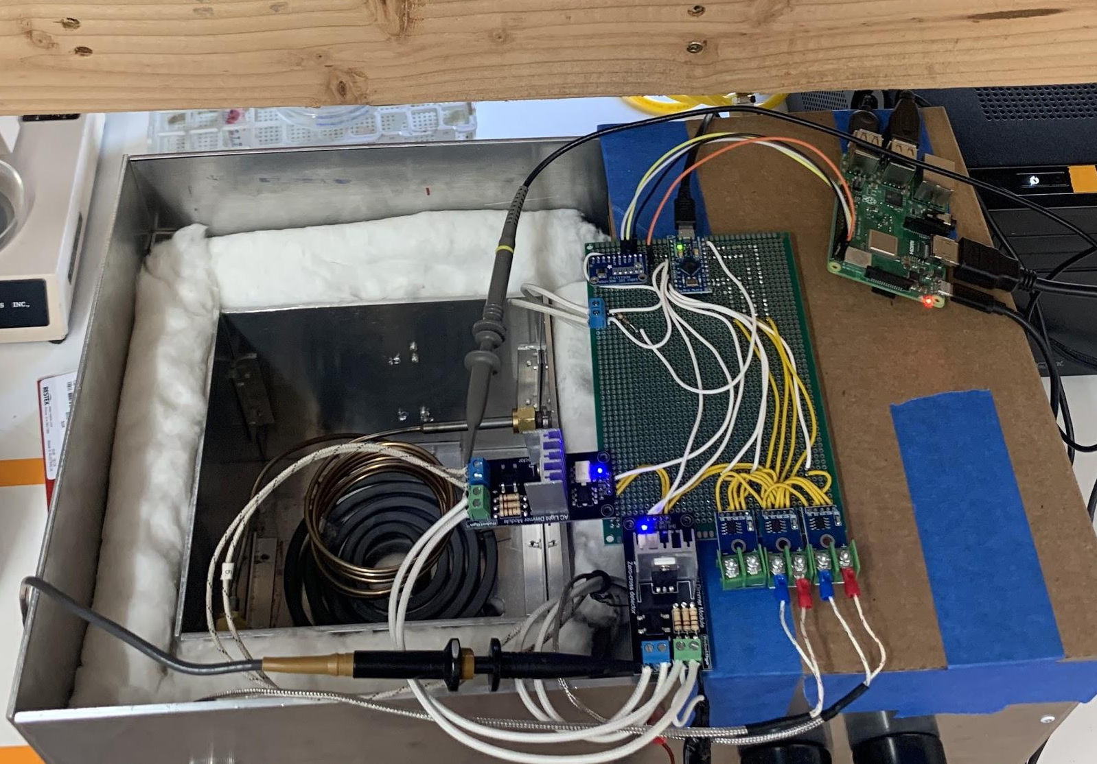
Current Prototype

Slide 10
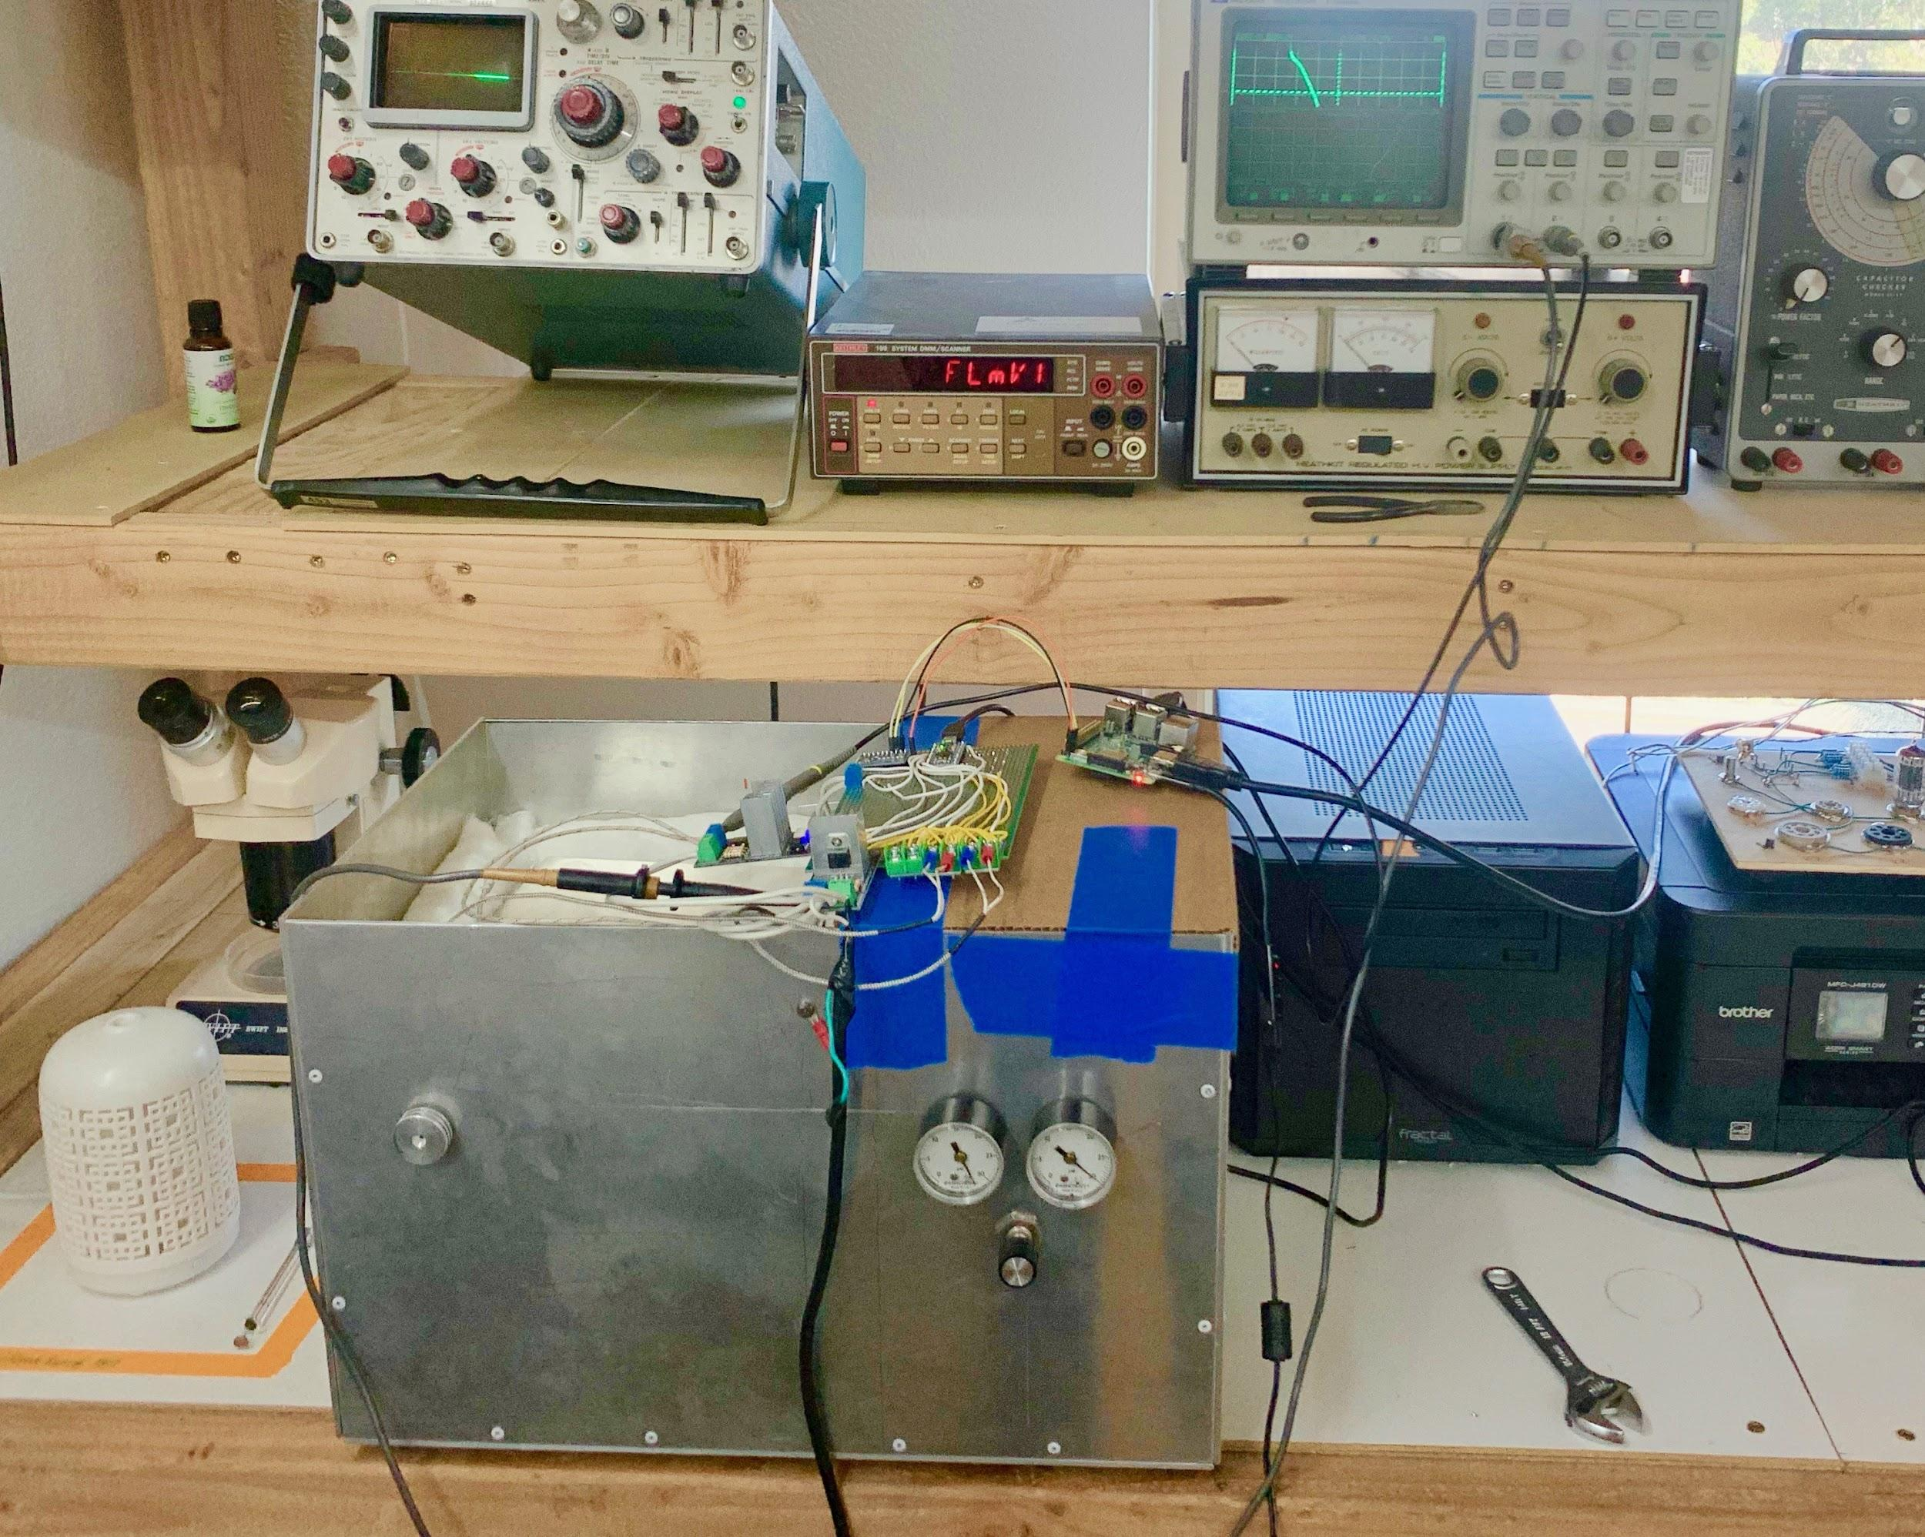
Review of Hardware Features
Single Diode and Compressed Air
TRIAC controlled temperature
Stability
Overtemperature protection
“Set and forget”
Diode detector
Tested to work in helium
Compressed air is not as good
Low thermal conductivity difference between air and sample
Carrier flow control
Regulated in two places
Adjustable on instrument
Column head pressure gauge
Gas inlet pressure guage

Slide 11
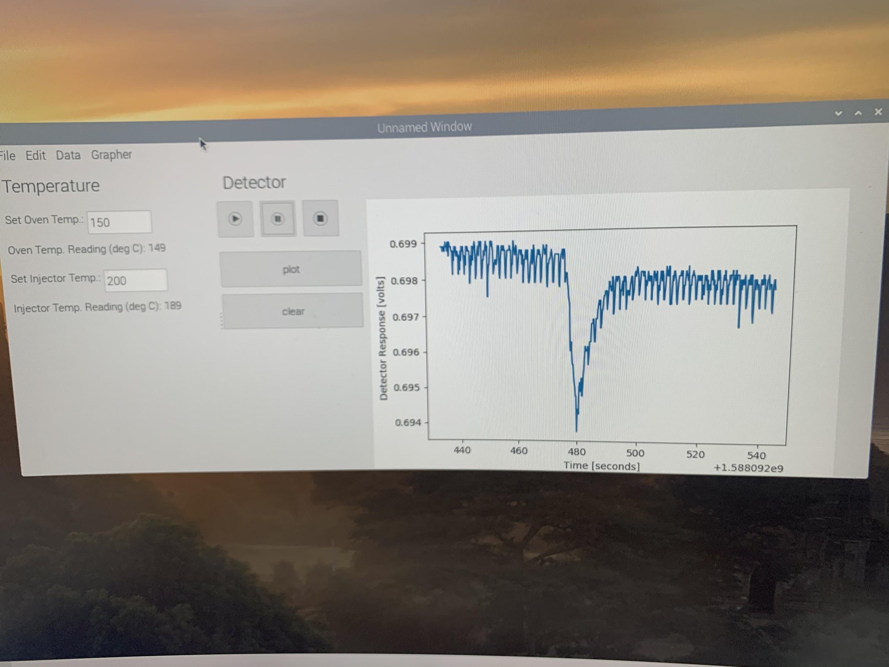
Results / Current Chromatograms

Slide 12
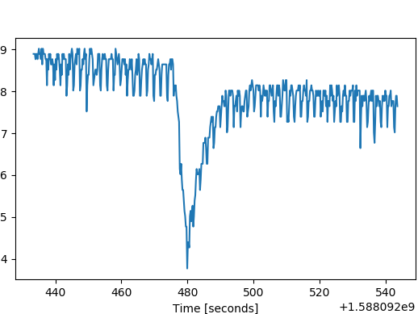
Results / Current Chromatograms
Exported as PNG from software utility

Slide 13
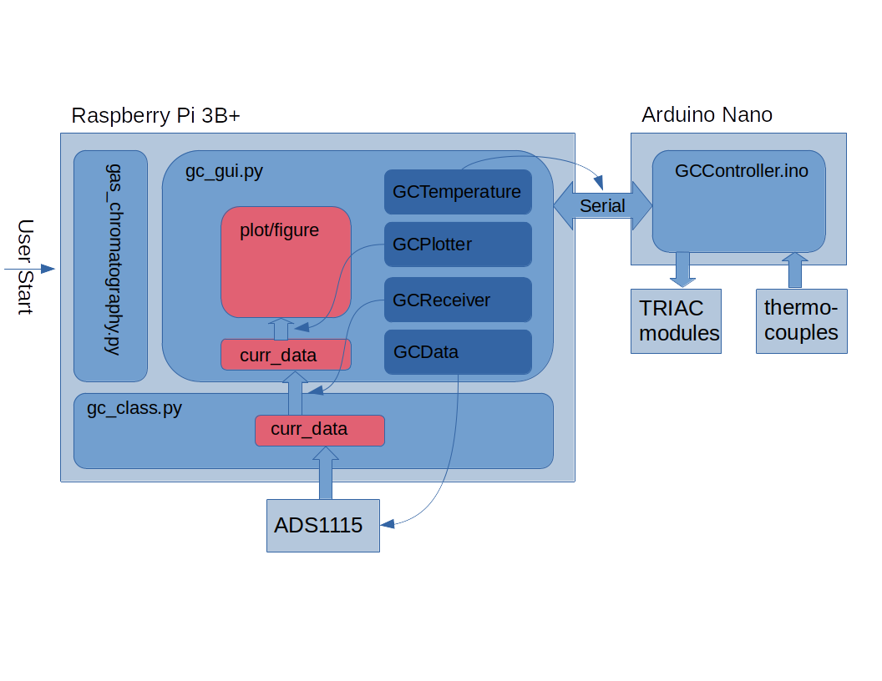
User Interface and GUI Design

Slide 14
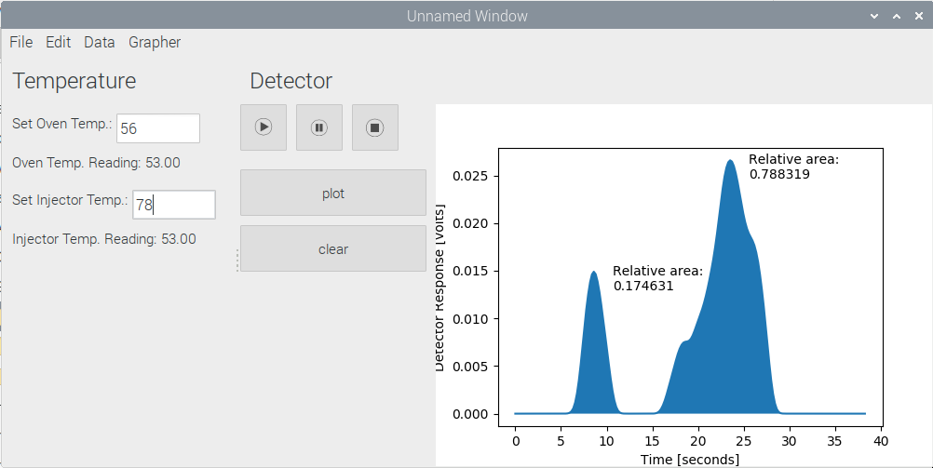
GUI Example
Separate YAML configuration file for default settings.
Threaded data collection and live plotting.
Math operations
Integrate data (voltage)
Normalize data (voltage)
Clean the time axis
Apply a low pass filter
Calculate relative area of peaks
Fill under data on plot.
Threaded temperature feedback text box updating.
Ability to set oven and injector temperatures.
Save current session as ".gc". file type (JSON data structure)
Save current plot as JPEG or PNG image.
Open previous session files (".gc") into the current window.

Slide 15
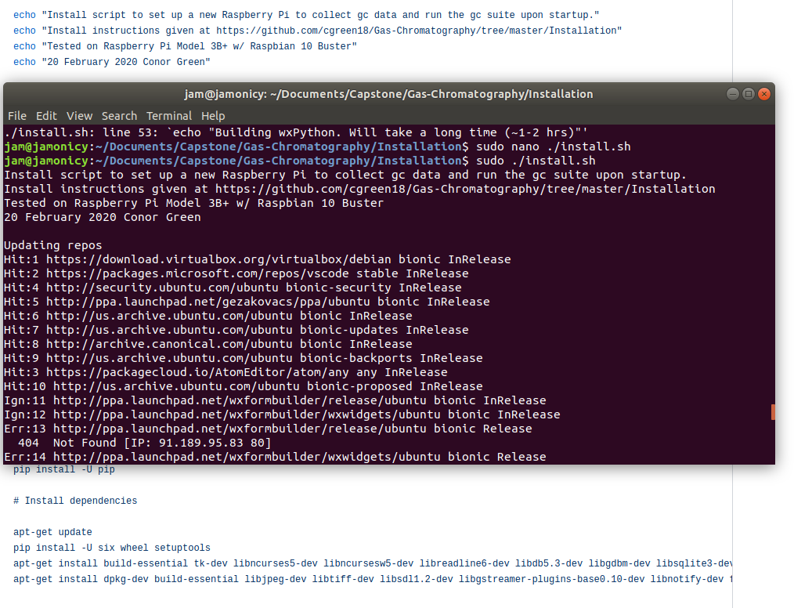
Full Stack
Fresh Raspberry Pi
Install and Configure scripts
Reboot and Autorun on startup

Slide 16
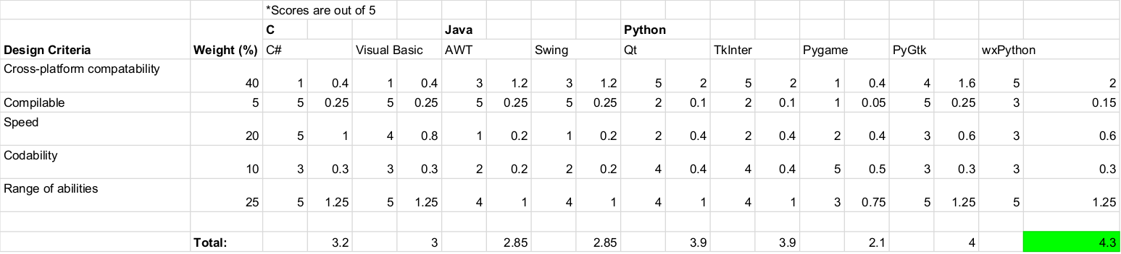
User Interface and GUI
wxPython
Raspberry Pi
Interface with Arduino Pro Micro via GPIO for analog voltage measurements

Slide 17
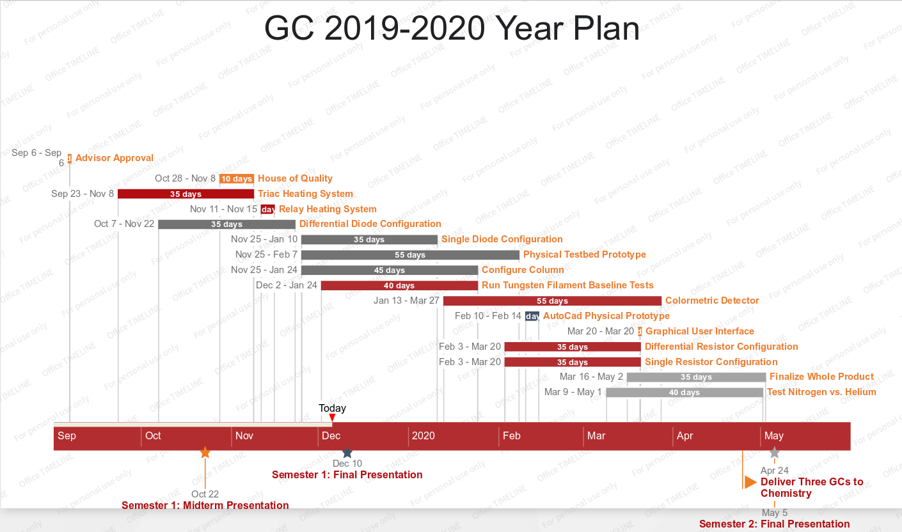
Development Plan
April
Mar. 30 - Apr. 5: Finish oven assembly and gas routing and finish software.
Apr. 6 - 12: Automate temperature management and assemble air compressor and dryer.
Apr. 13 - 19: Test and debug.
Apr. 20 - 26: Finalize product.
May
Apr. 27 - May 3: Report results.

Slide 18
Looking Forward
Hardware
Weld together walls of instrument shell.
Better gas flow rate control.
Variety of carrier gases to determine cheapest that yields sufficient signal-to-noise ratio.
Place electronics inside the shell for portability and application to educational setting.
Software
Ability for user to modify settings such as graph color and markers. This functionality was began with the GCConfigPopup class but was left unconnected in the final product (version 4).
Cutting/removing sections of data via a GUI tool.
GUI tool for zooming and moving around the plot.
Window/menu functionality to modify settings pertaining to the hardware (e.g. gas flow rate).
Proper error handling through custom exception classes: the code should throw informational exceptions for the programmer/user during new code testing or hardware set up. For example, currently nothing is done when no open serial ports are found (most likely unconnected cord) and this causes errors further down execution.
Printing to printer.
Notes:
Compile to executable to simplify start up and maintain source code security. For the reader's information, the YAML file type for defaults was chosen because it compiles well. Currently, there is no security on the code because it is raw Python.
More complex data structure
More variables/information on data collection
Possibly a better structure than 2D numpy array; although, numpy was specifically chosen for computational speed and functions.
Ability for user to modify settings such as graph color and markers. This functionality was began with the GCConfigPopup class but was left unconnected in the final product (version 4).
Cutting/removing sections of data via a GUI tool.
GUI tool for zooming and moving around the plot.
Window/menu functionality to modify settings pertaining to the hardware (e.g. gas flow rate).
Proper error handling through custom exception classes: the code should throw informational exceptions for the programmer/user during new code testing or hardware set up. For example, currently nothing is done when no open serial ports are found (most likely unconnected cord) and this causes errors further down execution.
Printing to printer.

Slide 19
References
K. Rakow, N. & Suslick. A colorimetric sensor array for odour visualization. Nature, 406:710–713, August 2000.
M. Jones. A simple-to-build thermal-conductivity gc detector. Journal of Chemical Education, 71:995–996, November 1994.

Slide 20
Objectives
Simple: Student can operate
Accurate: Detects impurities ≥ 5% of substance
Carrier gas: Air > nitrogen > helium
Safe
Durable and serviceable: ≥ 2 weeks uptime / service
Economic: ≤ $500/instrument
Documentation

